Slide 1
The 12-Factor App
Designing DevOps Excellence
by Evren Tan

Slide 2

About Me

Slide 3
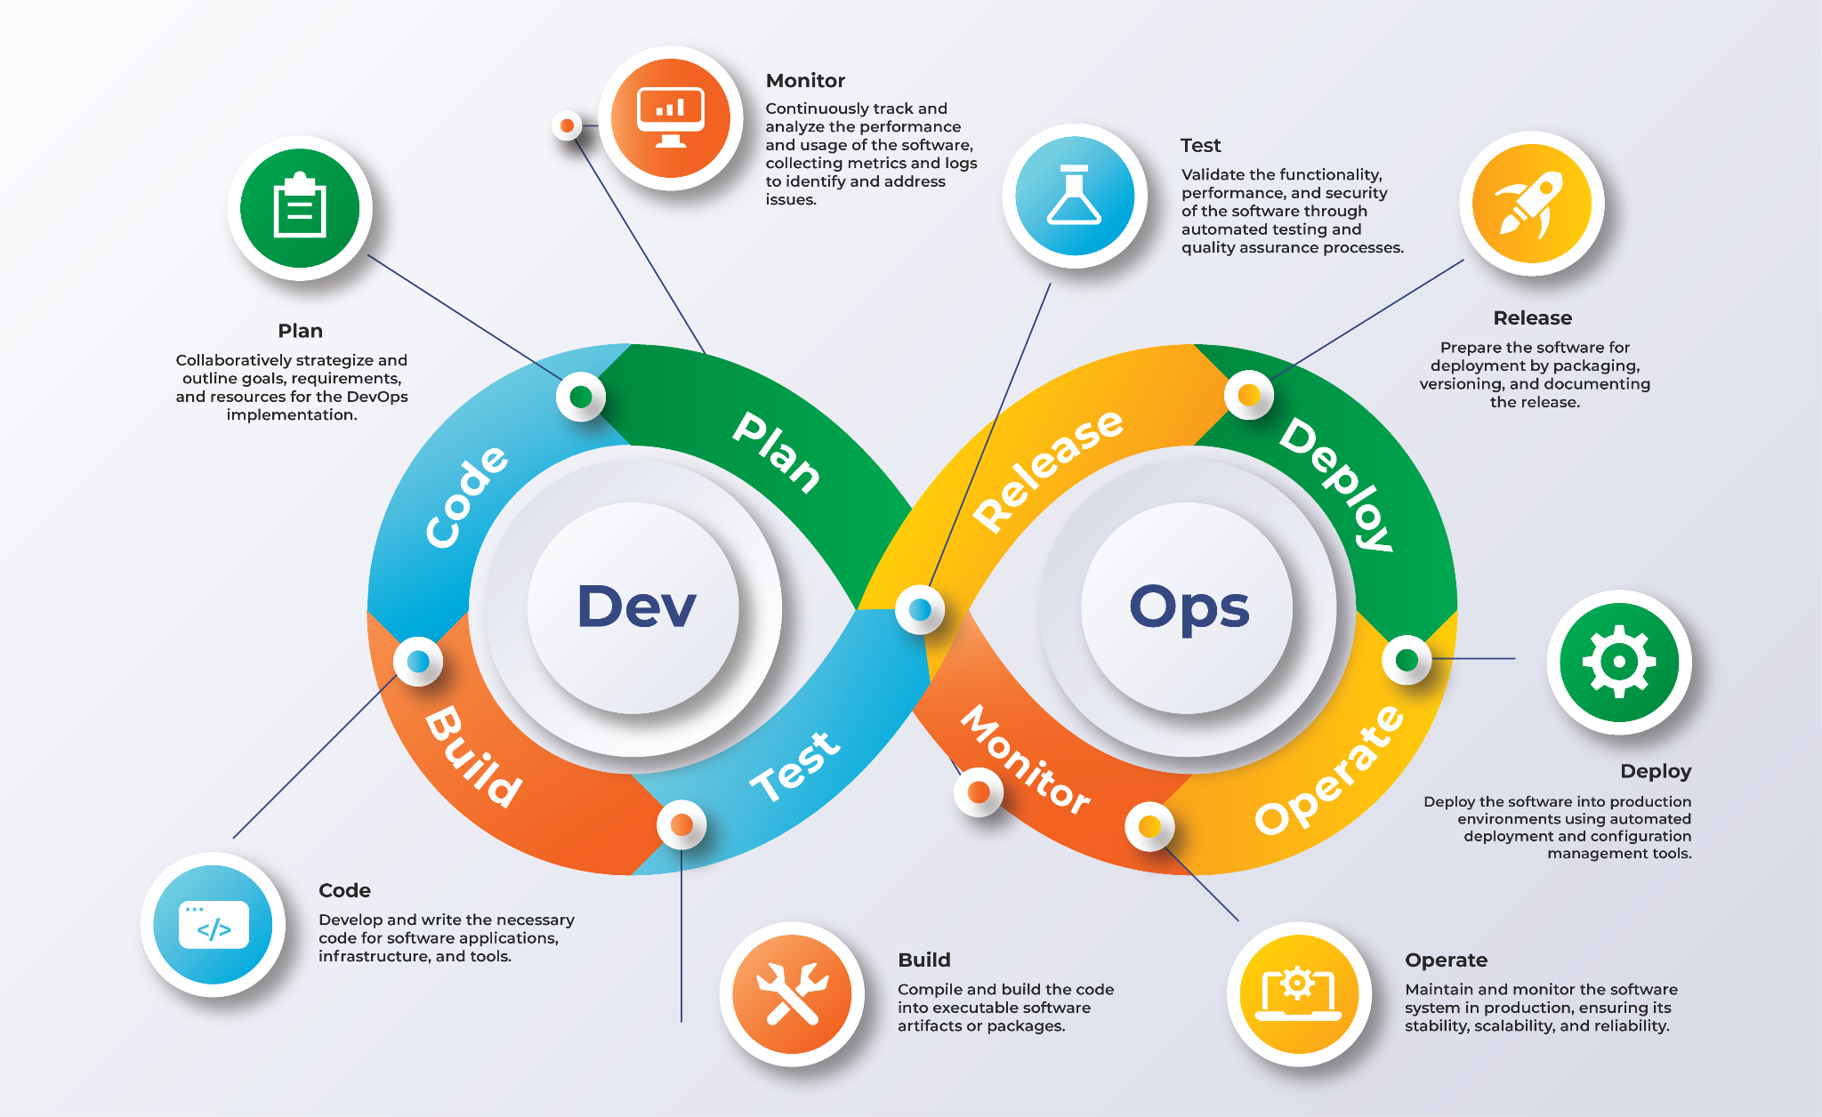
DevOps?
Image Ref: https://www.serole.com/blog/what-are-the-key-benefits-of-devops-for-businesses/
Notes:
Definition of DevOps:
DevOps is a cultural and technical movement that aims to improve collaboration between development (Dev) and operations (Ops) teams. It emphasizes automation, continuous delivery, and monitoring throughout the application lifecycle.
Core Principles of DevOps:
Collaboration: Encourages open communication and shared responsibilities between development and operations.
Automation: Focuses on automating repetitive tasks, such as testing, deployment, and infrastructure provisioning, to improve efficiency and reduce errors.
Continuous Integration/Continuous Deployment (CI/CD): Promotes frequent integration of code changes and automated deployments to ensure that software can be reliably released at any time.
Monitoring and Feedback: Involves continuous monitoring of applications in production to gather feedback and make informed improvements.
Benefits of DevOps:
Faster Time to Market: Shorter release cycles lead to quicker delivery of features and updates.
Improved Collaboration: Breaks down silos between teams, fostering a culture of collaboration and shared goals.
Increased Efficiency: Automating processes reduces manual effort and minimizes errors.
Enhanced Quality: Continuous testing and monitoring improve software quality and user satisfaction.

Slide 4
Is DevOps an Approach for Software Crafting Mindset?
Core Principles of DevOps | Software Crafting Manifesto
Collaboration: Encourages open communication and shared responsibilities between development and operations | A Community of Professionals: Not only individuals and interactions, but also a community of professionals
Automation: Focuses on automating repetitive tasks, such as testing, deployment, and infrastructure provisioning, to improve efficiency and reduce errors | Steadily Adding Value: Not only responding to change, but also steadily adding value
Continuous Integration/Continuous Deployment (CI/CD): Promotes frequent integration of code changes and automated deployments to ensure that software can be reliably released at any time | Well-Crafted Software: Not only working software, but also well-crafted software development and operations
Monitoring and Feedback: Involves continuous monitoring of applications in production to gather feedback and make informed improvements | Productive Partnerships: Not only customer collaboration, but also productive partnerships
🔗 https://manifesto.softwarecraftsmanship.org/

Slide 5
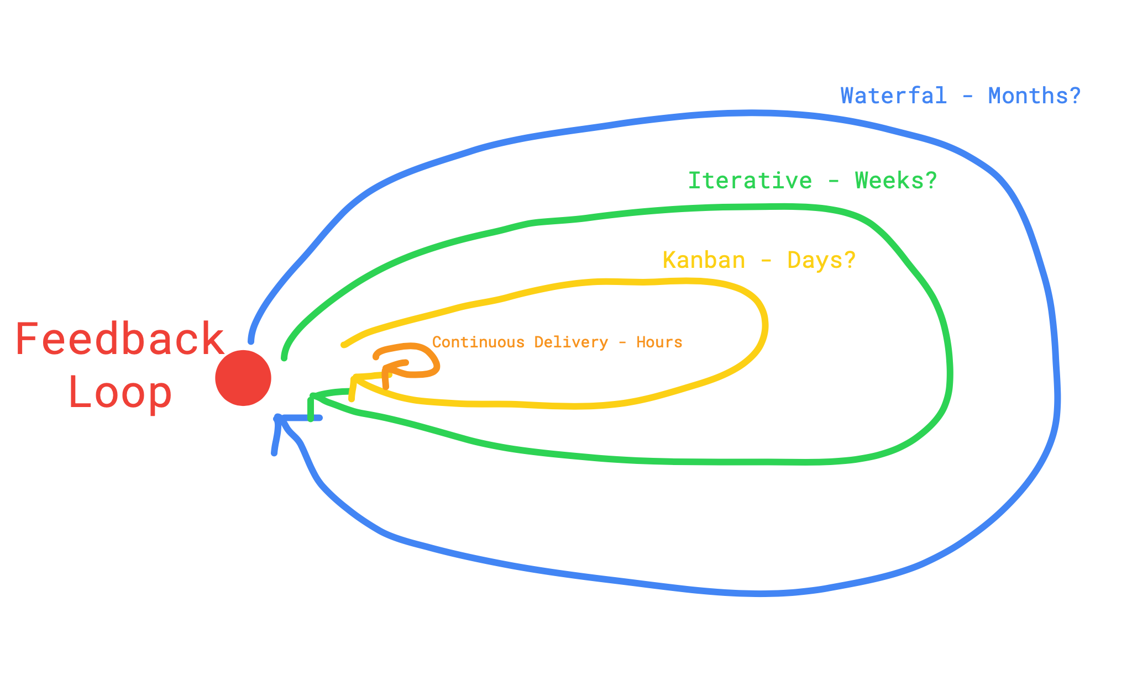
Feedback Loop?

Slide 6
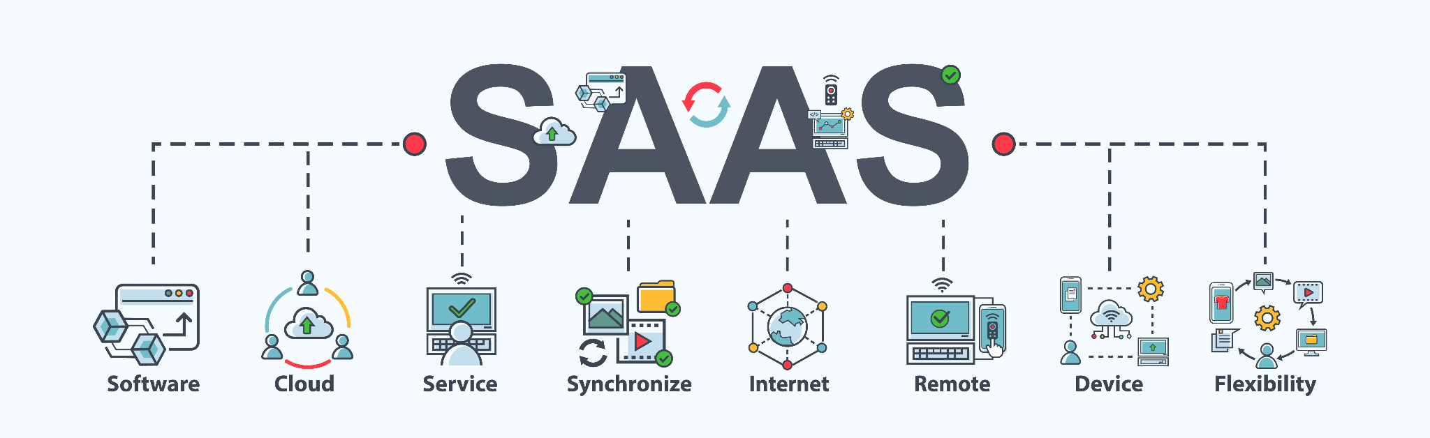

12-Factor App?
⭐️ A methodology for building SaaS apps that:
Use declarative formats for setup automation, to minimize time and cost for new developers joining the project;
Have a clean contract with the underlying operating system, offering maximum portability between execution environments;
Are suitable for deployment on modern cloud platforms, obviating the need for servers and systems administration;
Minimize divergence between development and production, enabling continuous deployment for maximum agility;
And can scale up without significant changes to tooling, architecture, or development practices.
The twelve-factor methodology can be applied to apps written in any programming language, and which use any combination of backing services (database, queue, memory cache, etc).
🔗 https://12factor.net/

Slide 7
And these factors are;
Codebase
Dependencies
Config
Backing Services
Build, Release & Run
Processes
Port Binding
Concurrency
Disposability
Dev/Prod Parity
Logs
Admin Processes

Slide 8
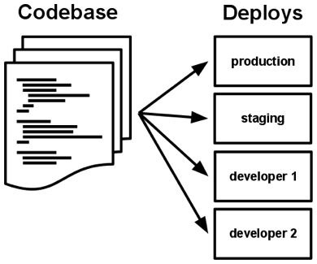
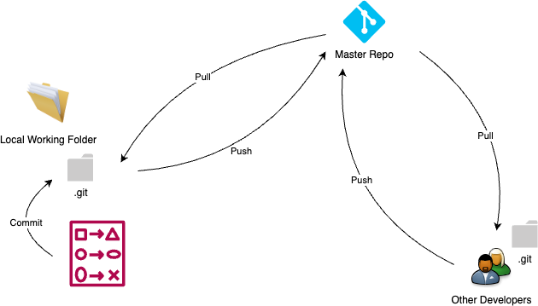
Codebase
❌ Multiple Codebases ≠ One App ➡️ A Distributed System
❌ Multiple Apps Sharing the Same Codebase
✅ One Codebase per App with Many Deploys
https://12factor.net/codebase

Slide 9
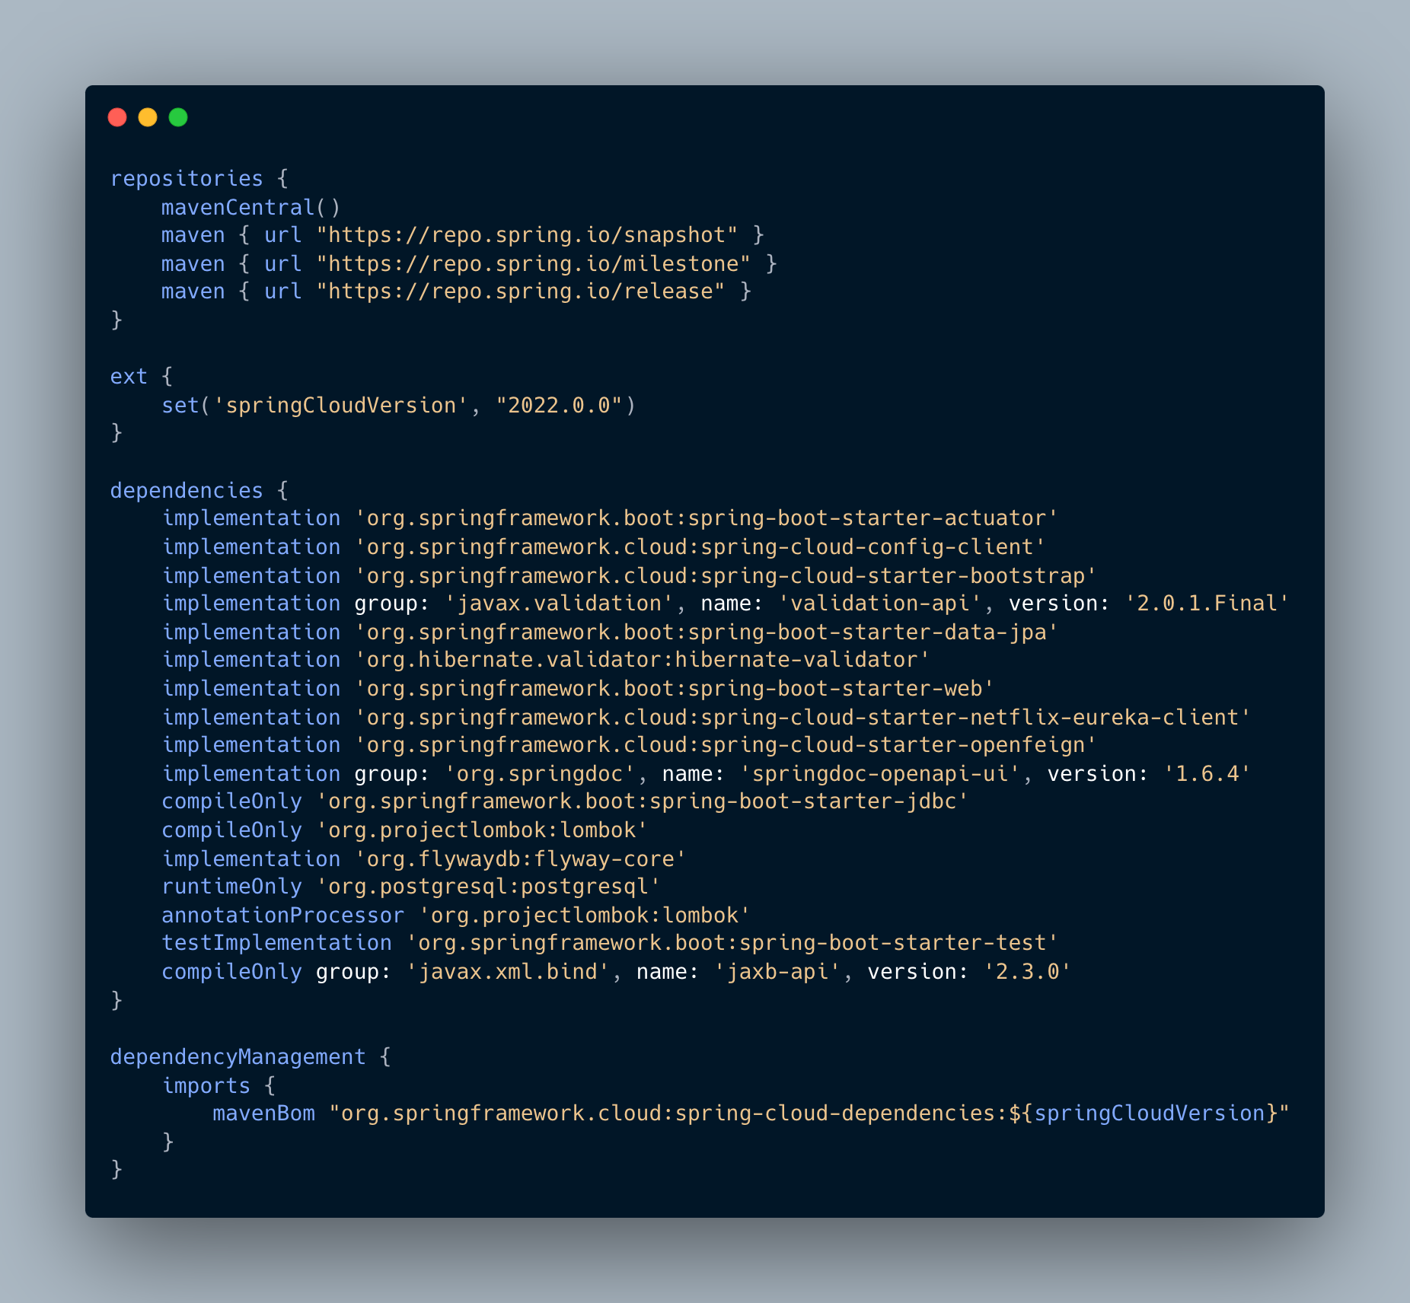
Dependencies
❗️A 12-factor app never relies on implicit existence of system-wide packages.
✅ It declares all dependencies, completely and exactly, via a dependency declaration manifest.
🧰 A dependency isolation tool

Slide 10
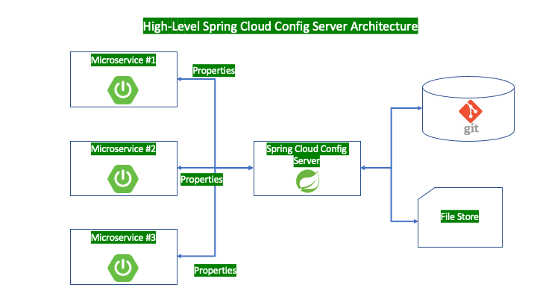
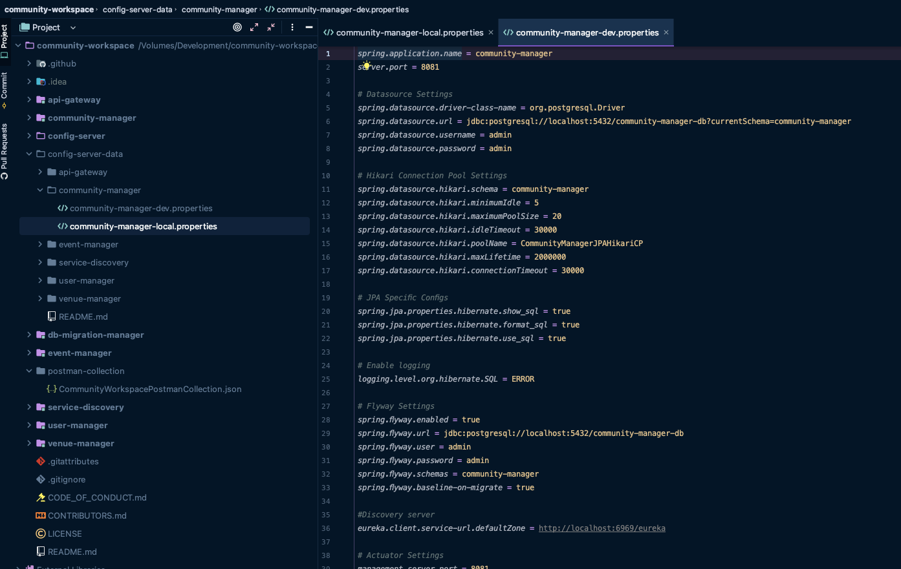

Config
❓Store configs static in the codebase ❌
✅ Strict Separation Config from the Codebase
✅ The twelve-factor app stores config in environment variables
♻️ Group configs in the same batch, i.e., dev, test, staging, production

Slide 11
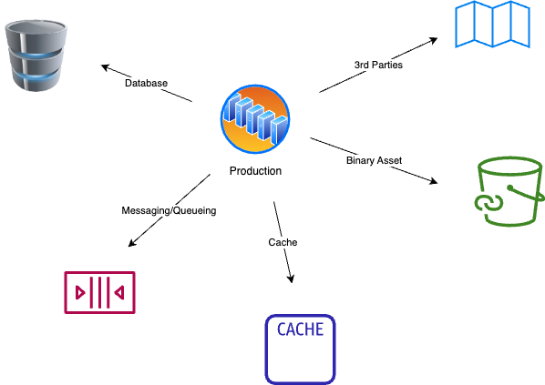
Backing Services
ℹ️ A backing service is any service the app consumes over the network as part of its normal operation.
➡️ Databases (PostgreSQL, MongoDB), Messaging/Queueing Services (Kafka, RabbitMQ), Caching (Redis), Metrics Gathering (New Relic, Loggly), Binary Asset Services (Amazon S3), API accessible 3rd Parties (Twitter, Google Maps, etc)
⭐️ Treat backing services as attached resources
🌟 Resources must be designed according to loose coupling pattern

Slide 12
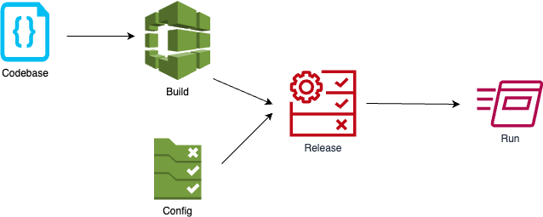
Build, Release & Run
❗️Strictly separate build, release and run stages
ℹ️ Three stages;
Build Stage
Release Stage
Run Stage

Slide 13
Processes
⭐️ Twelve-factor processes are stateless and share-nothing.
⭐️ Any data that needs to persist must be stored in a stateful backing service, typically a database.
✅ Execute the app as one or more stateless processes

Slide 14
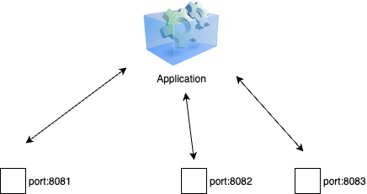
Port Binding
⭐️ Export services via port binding
ℹ️ Improves an application’s portability and security
🧐 An App has three services and all binds to different ports ❓
Scalability, portability, security, routing, load balancing (container native load balancing)
❓Treats like a backing service. Think about a Java app behind a Nginx web server

Slide 15
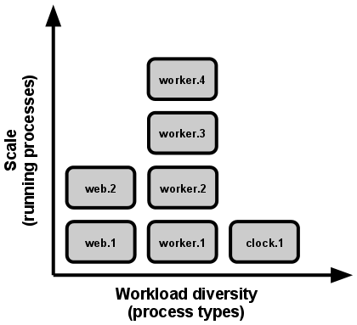
Concurrency
⭐️ Scale out via the process model
🥇 Processes are a first class citizen for a 12-Factor App
🏗️ The developer can architect their app to handle diverse workloads by assigning each type of work to a process type.
HTTP requests may be handled by a web process, and long-running background tasks handled by a worker process.
Image Ref: https://12factor.net/concurrency

Slide 16
Disposability
⭐️ Maximize robustness with fast startup and graceful shutdown
ℹ️ Processes are disposable, meaning they can be started or stopped at a moment’s notice.
⚖️ Fast elastic scaling
💻 Rapid deployment of code or config changes
💪🏻 Robustness of production deploys
💥 A 12-Factor app is architected to handle unexpected, non-graceful terminations ➡️ Crash-only Software ➡️ A software that crashes safely and recovers quickly

Slide 17
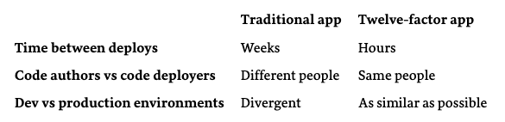
Dev/Prod Parity
⭐️ Keep development, staging, and production as similar as possible
ℹ️ The 12-factor app is designed for continuous deployment by keeping the gap between development and production small ➡️ Smaller Feedback Loop
❗️The twelve-factor developer resists the urge to use different backing services between development and production
🐳 Containerization tools like Docker

Slide 18
Logs
⭐️ Treat logs as event streams
ℹ️ Logs are the stream of aggregated, time-ordered events collected from the output streams of all running processes and backing services
❗️ A 12-factor app never concerns itself with routing or storage of its output stream
❌ Write to or manage log files in the local file system
✅ Write to STDOUT as unbuffered data

Slide 19
Admin Processes
ℹ️ What are Admin Processes;
Running DB migrations
Running reports
Running one-time scripts committed into the app’s repo
⭐️ Run admin/management tasks as one-off processes
✅ Each one of those processes should be run against a new instance having identical configs with the app
❗️Ensures that those background tasks do NOT have impact on the standard process

Slide 20

Q&A

